Slide 1

Olist E-Commerce Analysis
GROUP 3

Slide 2




INTRODUCTION
NAVIGATION
INSIGHTS
CHALLENGES

Slide 3



NAVIGATION PAGE
KPI 1
KPI 2
KPI 3
KPI 4
KPI 5
KPI 6
KPI 7
DASHBOARD

Slide 4

INTRODUCTION
Olist, where data analytics meets the forefront of E-commerce innovation. As a leading platform, Olist leverages cutting-edge data analytics to redefine online retail dynamics. Through sophisticated analysis of consumer behavior, market trends, and seller performance, Olist provides unparalleled insights, empowering businesses to make informed decisions and optimize their strategies for success.
In summary, this project showcases how advanced analytics can revolutionize E-Commerce operations, driving growth and resilience in an ever-evolving industry.
The Dataset included 9 csv files containing data about customers, products, Sales, Region etc which we merged in Power Query Editor and created one Merged Dataset.

Slide 5
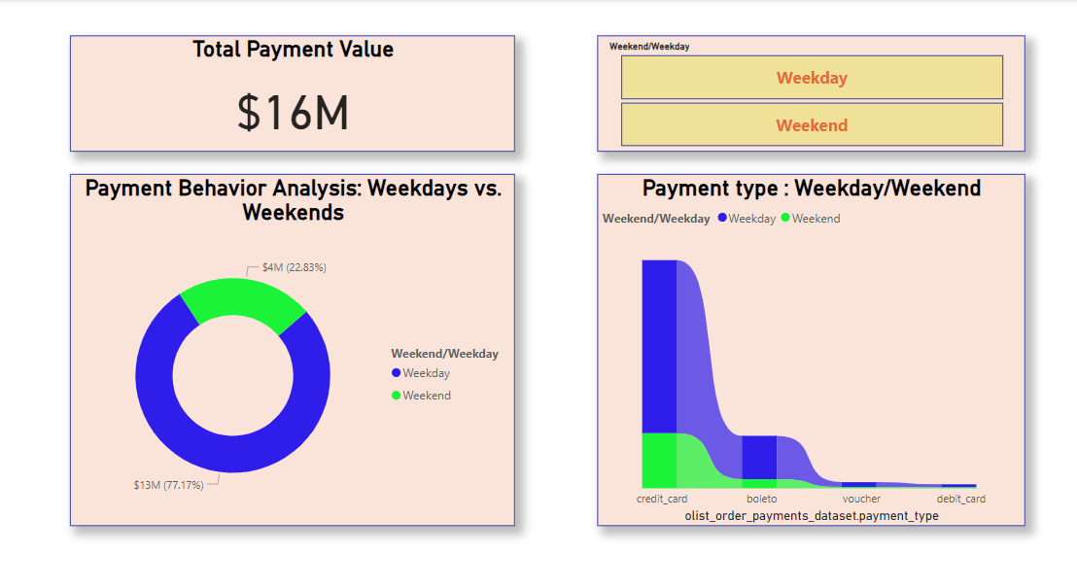

SUMMARY

Slide 6
KPI NO 1:- WEEKEND VS WEEKDAY ANALYSIS
TOTAL WEEKDAY PAYMENT VALUE :- 12,544 K
TOTAL WEEKEND PAYMENT VALUE :- 3,712 K
CONCLUSION:-
We have to concentrate more on weekend strategies.
In analyzing sales data on Olist, it's evident that weekends and weekdays each present unique opportunities for sellers.

Slide 7
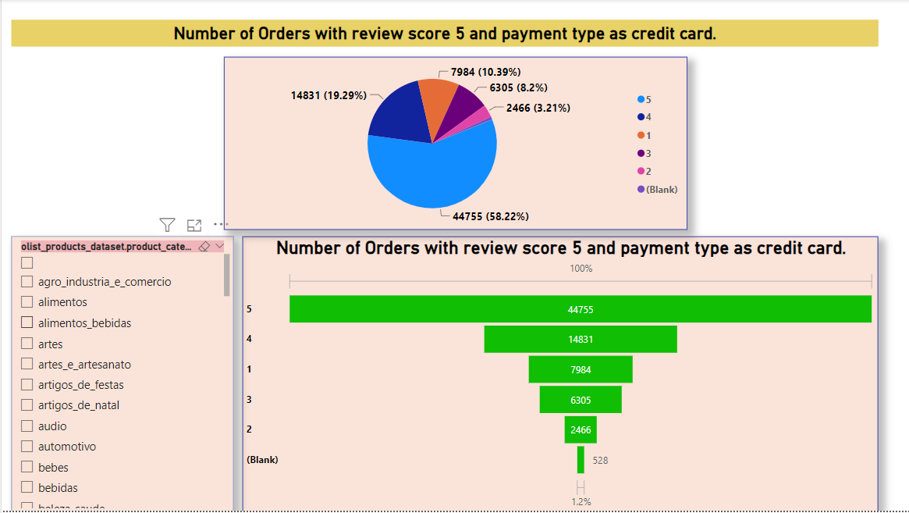
SUMMARY

Slide 8
KPI NO 2:- NO OF ORDERS BASED ON REVIEW SCORE 5 AND PAYMENT TYPE CREDIT CARD
Review Score 5 = 44755
Review Score 4 = 14831
Review Score 3 = 6305
Review Score 2 = 2466
Review Score 1 = 7984
CONCLUSION:-
More than 50 % Customers have given review score as 5.
We need to concentrate more on orders which have been given review score as 1.

Slide 9
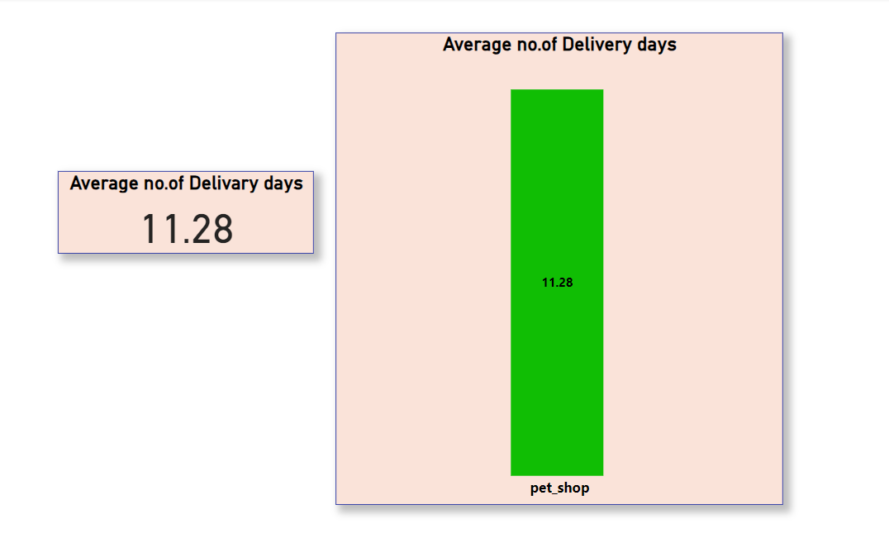
SUMMARY

Slide 10
KPI NO 3:- AVERAGE NUMBER OF DELIVERY DAYS FOR PET SHOP.
Average Number of Delivery Days = 11.28
Insights into its competitiveness and efficiency in meeting customer expectations.
CONCLUSION:-
Concentrate on continuous monitoring and optimization of delivery processes.
Customer Satisfaction is of utmost importance.

Slide 11
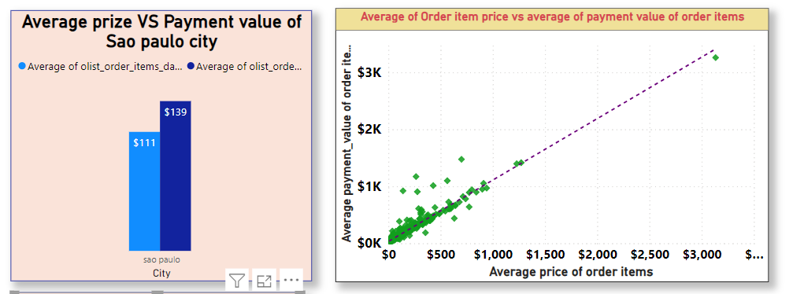
SUMMARY

Slide 12
KPI NO 4:- AVERAGE PRICE AND PAYMENT VALUE OF SAO PAULO CITY.
Average Price = 111 Dollars.
Average Payment Value = 139 Dollars.
CONCLUSION:-
Both the Quantities are related to each other.
Concentrate on Improvising Both the Quantities w.r.t Interests of Customers.

Slide 13
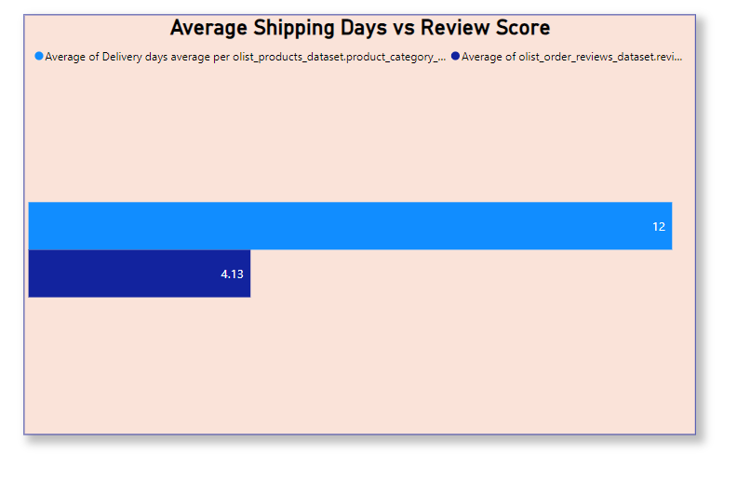
SUMMARY

Slide 14
KPI NO 5:- AVERAGE SHIPPING DAYS V.S REVIEW SCORE
On an Average Customers Have Given a Review Score of 4.13 Which Is Good.
On an Average It takes 12 Days To Deliver a Product.
Conclusion:-
We need to Improve The Average Delivery Time.
Need To Work On The Products Which are Affecting The Review Score.

Slide 15
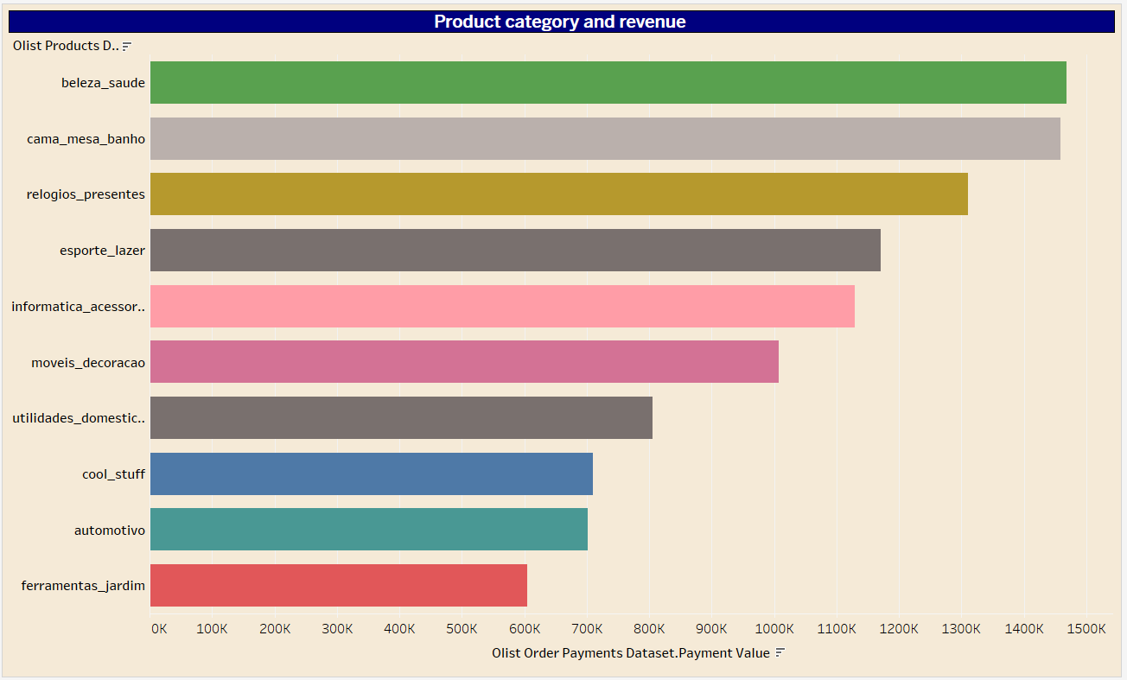
SUMMARY

Slide 16
KPI NO 6:- TOP 10 PRODUCT CATEGORY W.R.T REVENUE.
Health and Beauty is Leading Product Category.
All The 10 Product Categories are Giving More than 50 % Revenue.
Conclusion:-
We can Concentrate on Different Marketing Strategies and Segmentation.
Also We can Focus On Non Performing Product Categories.

Slide 17
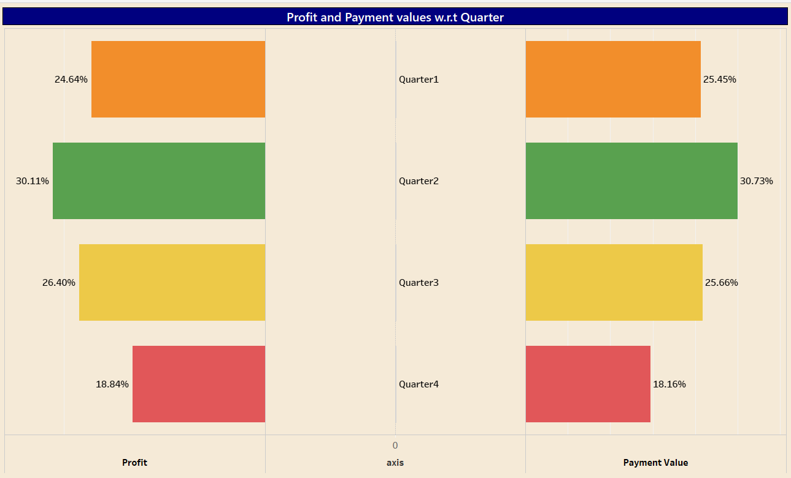
SUMMARY

Slide 18
KPI NO 7:- QUARTER WISE PROFIT AND PAYMENT.
Quarter 2:- Profit = 30.11 % & Payment = 30.73 %
Quarter 3:- Profit = 26.40 % & Payment = 25.66 %
Quarter 1:- Profit = 24.64 % & Payment = 25.45 %
Quarter 4:- Profit = 18.84 % & Payment = 18.16 %
Conclusion:-
Concentrate More On Quarter 4.
Need To Bridge the Gap Between Profit and Payment %.

Slide 19
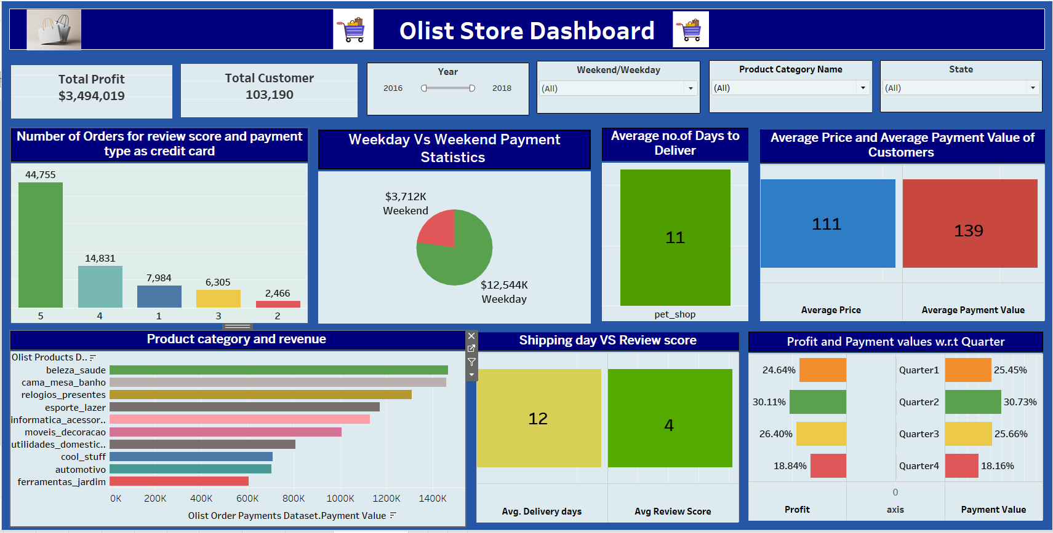
Tableau Dashboard

Slide 20
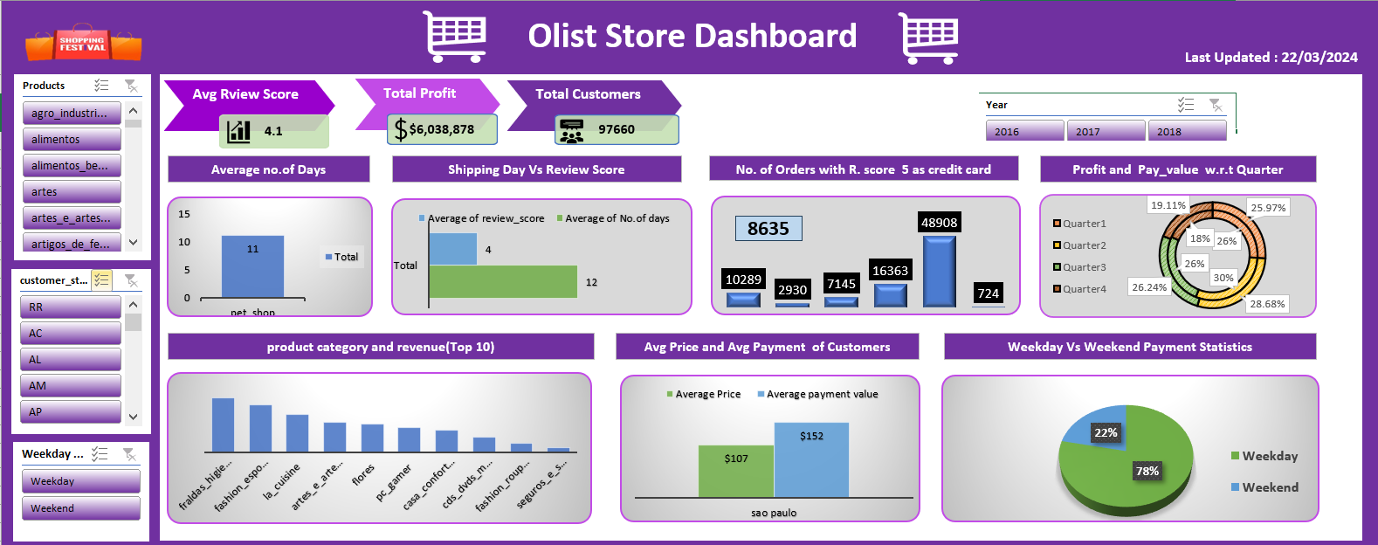
Excel Dashboard

Slide 21
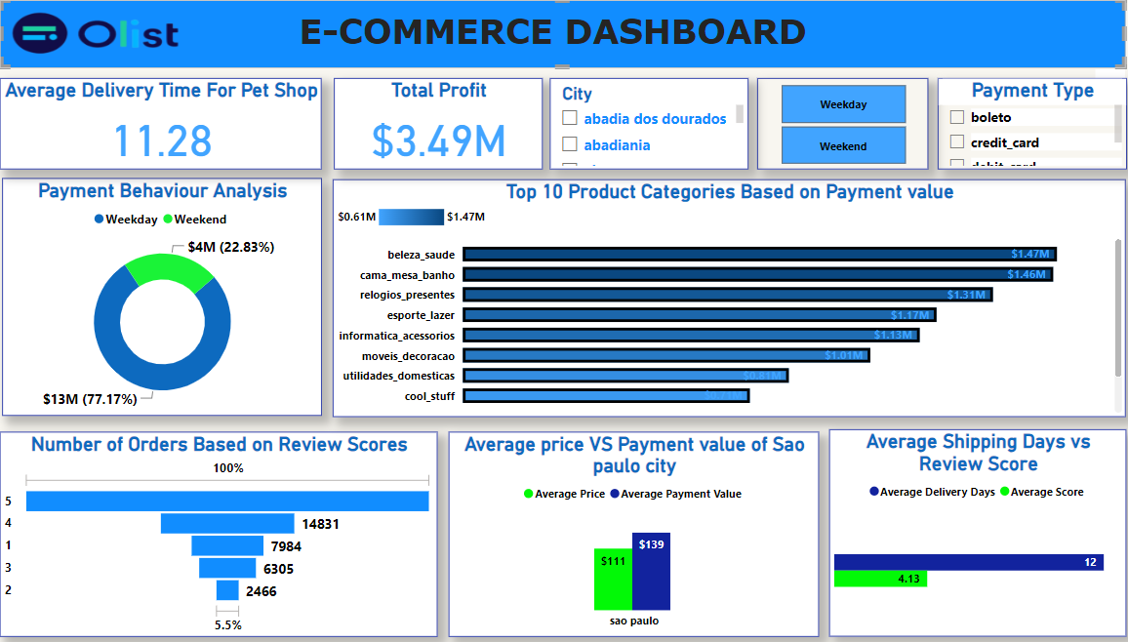
Power Bi Dashboard

Slide 22
INSIGHTS
KPI 1: Weekdays Contribute A Major Share of The Payment Value.
KPI 2: More than 50 % Customers have given review score as 5.
KPI 3: On an Average It Takes 11.28 Days To Deliver a Pet Shop Product.
KPI 4: There Exists a Positive Linear Relationship Between Average Payment Value and Average Price of Product.
KPI 5: The Average Delivery Time For Product Need To Be Reduced Further Which May Also Increase The Review Score.
KPI 6: Products Under Health and Beauty Category Are Giving Us The most Revenue.
KPI 7: Quarter 2 Is Turning Out Quite Profitable For Our Business.

Slide 23
Challenges:-
The dataset was quite huge and it took a lot of CPU power and time in order to load and modify it in power query editor.
Also proper merging of data was important in order to get exact outcomes of KPI’s.
Challenges Overcome:-
Since the data was huge SQL came handy to us in order to load it into our Data visualization tools like power bi and tableau.

Slide 24
THANK YOU!!

Slide 25
GROUP MEMBERS:-
Abhinav R Kumbalwar
Tripati Sahu
Yashashree D Gadre
Himanshu K Deoghare
Swathika Jangiti
Megha Rangaswamy

